Slide 1
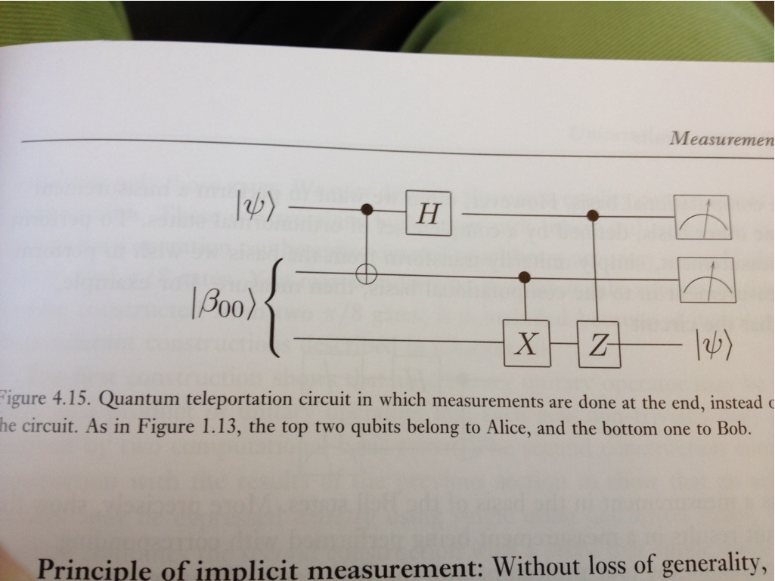
QML Lecture Hybridicing Neural network with PyTorch

Slide 2
Agenda for Lecture QML
8:30 – 9:00 CHSH round-up
9:00 - 9:15 Break – probably !
9:15 – 10:00 QML
10:15 – 11:00 Quantum Computing of TensP.
11:00 – 11:45 Video 6.3 Teleport. 1+ Q.C.TP
11:45 – 12:30 Lunch
12:30 – 13:15 Video 6.4 Teleportation 2
13:30 – 14:00 Exam questions & Multiplechoi.

Slide 3
Hybrid quantum-classical Neural Networks with PyTorch and Qiskit
Machine learning (ML) has established itself as a successful interdisciplinary field which seeks to mathematically extract generalizable information from data. Throwing in quantum computing gives rise to interesting areas of research which seek to leverage the principles of quantum mechanics to augment machine learning or vice-versa. Whether you're aiming to enhance classical ML algorithms by outsourcing difficult calculations to a quantum computer or optimise quantum algorithms using classical ML architectures - both fall under the diverse umbrella of quantum machine learning (QML).
In this chapter, we explore how a classical neural network can be partially quantized to create a hybrid quantum-classical neural network. We will code up a simple example that integrates Qiskit with a state-of-the-art open-source software package - PyTorch. The purpose of this example is to demonstrate the ease of integrating Qiskit with existing ML tools and to encourage ML practitioners to explore what is possible with quantum computing.
The Link to the Qiskit exercise
https://qiskit.org/textbook/ch-machine-learning/machine-learning-qiskit-pytorch.html

Slide 4
Contents
How Does it Work? 1.1 Preliminaries
So How Does Quantum Enter the Picture?
Let's code! 3.1 Imports 3.2 Create a "Quantum Class" with Qiskit 3.3 Create a "Quantum-Classical Class" with PyTorch 3.4 Data Loading and Preprocessing 3.5 Creating the Hybrid Neural Network 3.6 Training the Network 3.7 Testing the Network
What Now?

Slide 5
1. How does it work?
Fig.1 Illustrates the framework we will construct in this chapter. Ultimately, we will create a hybrid quantum-classical neural network that seeks to classify hand drawn digits. Note that the edges shown in this image are all directed downward; however, the directionality is not visually indicated.

Slide 6
Preliminaries
The background presented here on classical neural networks is included to establish relevant ideas and shared terminology; however, it is still extremely high-level. If you'd like to dive one step deeper into classical neural networks, see the well made video series by youtuber 3Blue1Brown. Alternatively, if you are already familiar with classical networks, you can skip to the next section.

Slide 7
So How Does Quantum Enter the Picture?
To create a quantum-classical neural network, one can implement a hidden layer for our neural network using a parameterized quantum circuit. By "parameterized quantum circuit", we mean a quantum circuit where the rotation angles for each gate are specified by the components of a classical input vector. The outputs from our neural network's previous layer will be collected and used as the inputs for our parameterized circuit. The measurement statistics of our quantum circuit can then be collected and used as inputs for the following layer. A simple example is depicted below:

Slide 8
Sum-up
Input
Hidden
Output
Activation
Sigmoid
Bias
Relu

Slide 9
1

Slide 10
1

Slide 11
1

Slide 12
1

Slide 13
1

Slide 14
1

Slide 15
1

Slide 16
1

